Slide 1
Software Engineering
Prepared by: Neha Tripathi

Slide 2
Software Crisis
Software crisis is the situation resulted due to the increment in failure rate of software development which leads to incomplete and degrading performance of software products.
Term was coined in the year 1968.
In general it refers to poorly written, hard to read, error-prone software that often lacks good documentation.
The term software crisis revolves around three concepts: complexity, change and the expectations.

Slide 3
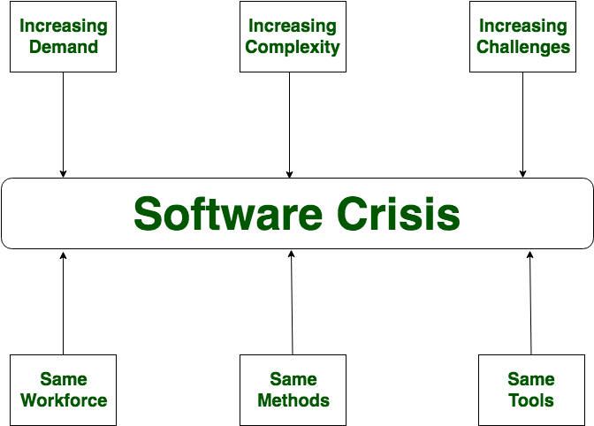
Software Crisis

Slide 4
Software Crisis in terms of statistics
success 16%
failure 31%
over budget 53%

Slide 5
Problems of software crisis:
Projects running over-budget
Projects running over-time
Software was very inefficient
Projects were unmanageable and code difficult to maintain
Software was of low quality
The software often did not meet requirements

Slide 6
Factors contributing to the software crisis
Large and complex problems,
Lack of adequate training in software engineering,
Increasing skill shortage,
Low productivity improvements,
Requirement change is inevitable,
Requirement gets frozen,
Customer themselves are not clear with their requirements,
Market demand/conditions changes,
Manpower turnover,
Technology/Process change,
etc.

Slide 7
Example
Y2K problem
-related to date format
-problem arise in year 2000
- all the softwares stopped working
-format changed from ddmmyy to ddmmyyyy.
-example:
-In 19th century date format used was ddmmyy(say 1st jan 1999 was written as 010199 and it year is assumed to be 1999 by default )
- but, when 20 th century came, (say 1 st jan 2000 was written as 010100 and according to old format year was assumed to be 1900)
- so all the software failed.
-currently, we use yyyy instead of yy.

Slide 8
Thank You!

